Slide 1
African Growth & Opportunity Act
Overview of Law
Advantages
Outlook for the Future
Jan Forest
May 8 2019
Sponsored by

Slide 2
Overview of Law
AGOA provides unilateral preferences similar to GSP
Signed into law May 18, 2000 and extended through 2025 in 2015 with strong bipartisan Congressional support
AGOA adds 1,800 products to GSP including import sensitive products (such as textiles and apparel)
Textiles and apparel are eligible under special origin rules in Chapter 98 of the HTSUS

Slide 3
Rules of Origin for AGOA
Non-textile goods are subject to the GSP rules of origin
Wholly produced or substantially transformed
35% local processing requirement
Textiles and apparel are subject to special origin rules under Chapter 98, Subchapter XIX of the HTSUS
Only countries with an effective visa system are eligible (U.S. Note 1 to Chapter 98)
Goods must fit within one of the 10 categories listed on the AGOA Textile Certificate of Origin
35% local processing requirement does not apply

Slide 4
Special Document Requirements for AGOA Textiles
AGOA Certificate of Origin (handout number 1)
Invoice stamped with original AGOA visa (handout number 2)
Need separate visa stamp on invoice for each category of goods
Importer must make written declaration by including Chapter 98 subheading on entry documents

Slide 5
Advantages under AGOA
Provides a large duty saving compared to other regions of the world
GSP does not include textiles/wearing apparel
NAFTA has restrictive yarn forward rule and change in heading
DR/CAFTA has yarn forward (and sometimes fiber forward) in addition to change in heading rule
Primary advantage of AGOA over GSP is inclusion of sensitive products such as textiles and apparel
The procedure has been tried and tested in Ghana and Benin
The required visa stamp and authorized signatures are in place

Slide 6
Classification and Duty Considerations for Uniforms, Scrubs
Product | Style | Classification considerations | Gender | HS codes | Duty
Uniforms (All 65P/ 35C) | Top | Uniform tops classified as: Shirts (left over right) Blouses (right over left or unisex) | Men | 6205.30.20 | 29.1 c/kg + 25.9%
 |  |  | Women | 6206.40.30 | 26.9%
 | Bottom | Uniform bottoms classified as: Pants/Trousers | Men | 6203.43.90 | 27.9%
 |  |  | Women | 6204.63.90 | 28.6%
 | Chef jacket | Classified as men’s shirts or women’s shirts (unisex) | Men | 6205.30.20 | 29.1 c/kg + 25.9%
 |  |  | Women | 6206.40.30 | 26.9%
Scrubs (All 65P/ 35C) | Top | Scrub tops classified as shirts/ blouses [Below waist with pockets may be 6211.33.90 (men) or 6211.43.90 (women) both 16%] | Men | 6205.30.20 | 29.1 c/kg + 25.9%
 |  |  | Women | 6206.40.30 | 26.9%
 | Bottom | Scrub bottoms classified as pants | Men | 6203.43.90 | 27.9%
 |  |  | Women | 6204.63.90 | 28.6%

Slide 7
Classification and Duty Considerations for Pajamas
Product | Classification considerations | Style | Gender | Fabric | HS | Duty
Pajamas | Pajamas are generally two-piece garments worn for sleeping; tops and pants are classified as pajamas if they are marketed as sleepwear and designed for a “private activity;” they are considered loungewear (classified in the higher duty-rate provisions for shirts and pants) if they are designed for a more “public” activity such as socializing at home with friends, walking the dog, etc. | Nightgown | Women | Knit cotton | 6108.31.00 | 8.5%
 |  |  |  | Woven cotton | 6208.21.00 | 8.9%
 |  | Robe | Men | Knit cotton | 6107.91.00 | 8.7%
 |  |  |  | Woven cotton | 6207.91.10 | 8.4%
 |  |  | Women | Knit cotton | 6108.91.00 | 8.5%
 |  |  |  | Woven cotton | 6208.21.00 | 7.5%
 |  | Knit top & Flannel pants | Men | Knit cotton | 6107.21.00 | 8.9%
 |  |  |  | Woven cotton | 6207.21.00 | 8.9%
 |  |  | Women | Knit cotton | 6108.31.00 | 8.5%
 |  |  |  | Woven cotton | 6208.21.00 | 8.9%

Slide 8
Classification and Duty Considerations for Jackets
Product | Style | Fabric | Gender | HS code | Classification considerations | Duty
Jacket | Soft shell | Synthetic | Men | 6201.93.47 | Recreational performance/ water resistant | 7.1%
 |  |  |  | 6201.93.49 | Recreational performance/ not water resistant | 27.7%
 |  |  |  | 6201.93.60 | Not recreational performance/ water resistant | 7.1%
 |  |  |  | 6201.93.65 | Not recreational performance/ not water resistant | 27.7%
 |  |  | Women | 6202.93.07 | Recreational performance/ water resistant | 7.1%
 |  |  |  | 6202.93.09 | Recreational performance/ not water resistant | 27.7%
 |  |  |  | 6202.93.48 | Not recreational performance/ water resistant | 7.1%
 |  |  |  | 6202.93.55 | Not recreational performance/ not water resistant | 27.7%
Summary: For non water resistant soft shell jackets, 27.7% duty advantage under AGOA

Slide 9
Classification and Duty Considerations for Kids Clothing
Product | Classification considerations | Style | Fabric | Gender | HS | Duty
Kidswear | The expression "babies' garments and clothing accessories" means articles for young children of a body height not exceeding 86 centimeters Boys classified the same as mens’ Girls classified the same as womens’ Unisex classified as womens’ | Poloshirt | 100% cotton pique | Boy | 6105.10.00 | 19.7%
 |  |  |  | Girl | 6106.10.00 | 19.7%
 |  | Leggings | 95%C/ 5% span |  | 6104.62.20 | 14.9%
 |  | Jeggings | 60%C/ 35%P/ 5% span |  | 6104.62.20 | 14.9%
 |  | Chinos | 100%C | Boy | 6203.42.45 | 16.6%
 |  |  |  | Girl | 6204.62.80 | 16.6%

Slide 10
Case Study
Inquiry from company was to ask whether articles imported and then sold to religious institutions qualify for duty-free treatment under 9810
Stoles to wear over clothing
Baptismal stoles and bibs
Collars and collarettes
Main findings
Prayer shawls and head wear used for public or private observances are covered under 9810, but customs ruling interprets this very narrowly
Chapter 71 has provisions for religious articles worn on apparel or carried by the person, dutiable at 3.3% or 3.9%
All of the articles in this case qualify as wearing apparel under Chapter 62 and are duty free under AGOA

Slide 11
Outlook for the future
AGOA in effect until 2025
Post-AGOA trade relationship
Transition from aid-based assistance to trade-based assistance
U.S. looking for increasing self-reliance
FTA with U.S. would lock in benefit of AGOA
Ghana being considered for model FTA for all of Africa

Slide 12
Appendix

Slide 13
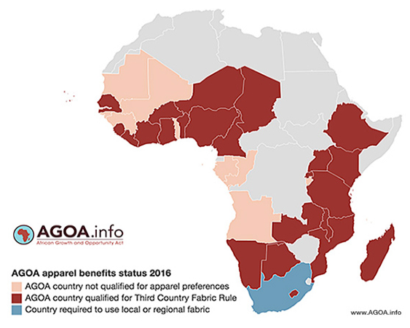
AGOA eligibility map

Slide 14
Labeling Requirements for Textiles
Country of origin marking
Every article of foreign origin imported into the US must be legibly marked with the with the English name of the country of origin prior to shipment unless an exception from marking is provided
Textile labeling requirements (handout 3)
FTC regulations govern labeling of textiles with:
▪ Fabric content
▪ Country of origin
▪ Name of manufacturer or importer

